Slide 1

SUSTAINABILITY REPORT
ATLANTICA AEGEAN PARK HOTEL
REPORTING PERIOD:
MARCH 2021 - AUGUST 2024
Report issued on: 27/09/2024_v1
Prepared by: Kyriaki Bakiri
Reviewed& Approved by: Sanja Saler
Chief Sustainability &Compliance Officer I DPO

Slide 2
ATLANTICA HOTELS & RESORTS – AT GLANCE
Established in 1980, Atlantica Hotels & Resorts has now grown into a hotel chain that currently operates over 45 hotels in Cyprus, Greece and Egypt.
Through the years, terms like:
Customer focus
Personalised Service
Attention to detail
Value for money
Sustainability
Atlantica Aegean Park have become synonymous with Atlantica Hotels & Resorts!
Value is maximised further with working closely with our partners, communities and key account clients.
Due to the challenging economic, social and environmental periods, our main goal is to balance well the needs of these three main challenges and yet achieve highest customer satisfaction with minimum on the society and environment.
With a wealth of experience and an enviable reputation for quality of service, Atlantica Hotels wherever located, guarantee customer satisfaction at lowest environmental and social impact.
Our customer-focused approach is founded on attracting, retaining and deepening the relationships with our customers. Customer trust is our most valuable business asset and the foundation for our future growth.
2

Slide 3

“
Responsible business is one of the company’s most important values.
3

Slide 4

Atlantica Aegean Park Hotel Sustainability Team is committed to provide highest customer satisfaction at the lowest environmental and social impact by implementing Travelife requirements.
Atlantica Aegean Park is part of the Atlantica Hotels& Resorts chain of hotels and therefore has adopted all corporate polices:
Quality
Sustainability
Food Safety
HSE
Discrimination, Violence & Harassment at work policy
Atlantica Aegean Park Hotel has evaluated its environmental and social impacts and below actions and measures are the ones carried out in order to minimize the impact from our activities.

Slide 5
About Hotel:
You’ll find the Atlantica Aegean Park beautifully located right on the beach, overlooking the crystal clear waters of the Aegean Sea.
A warm Greek welcome from our eleven times awarded All-Inclusive resort hotel perfectly positioned in the middle of the East Coast Island ideal to explore all of Rhodes treasures and blessed beaches. Under of the protection of the saint Tsambika mountain known for her miracles and in front of Kolymbia Mediterranean sea, our location is matched only by the standard of staff service, Rhodian hospitality, enhanced water features Activities & Entertainment all in a country known for its great food. Our best environmental choice. Here you will stay extra green.
The hotel sits right up to the beach front within the resort of Kolymbia and within a five minute walk you are in the resort centre where you will find a variety or bars, shops and tavernas.

Slide 6
OUR COMMMITMENT
Atlantica Hotels and Resorts is firmly committed to environmental responsibility and sustainability in all aspects of its operations.
We understand the importance of protecting the environment for the well-being of current and future generations.
We are collectively dedicated to upholding the same standards of excellence and social responsibility.
By teaming up with our employees, customers, associates, brands, partners, suppliers, and other business collaborators, we affirm our commitment to:
Reducing greenhouse gas emissions by minimizing energy and water usage, reducing waste, and limiting the consumption of high-emission foods.
Protecting and supporting biodiversity by reducing pollution and safeguarding nature and wildlife.
Protecting and respecting human rights by preventing discrimination, exploitation, and harassment, and promoting fair treatment for all.
Safeguarding children by preventing their exploitation or abuse and promptly reporting any suspected incidents.
Our public sustainability documents include commitments in the aforementioned areas, demonstrating our dedication to comprehensive sustainability practices.
Additionally, we have set specific goals, such as reducing our greenhouse gas emissions and achieving at least one other target related to our sustainability initiatives.
We adhere to crucial EU sustainability regulations, covering environmental, social, and governance aspects by introduction a bespoke ESH platform which is intended to help hotels report their performance.
We invite all stakeholders to support us in achieving these goals and commitments.
For transparency and broader engagement, our public sustainability documents are available online, ensuring that guests, the public, and other stakeholders can access and understand our sustainability efforts.
The following report sections indicate the hotel performance.

Slide 7

ESG REPORTING SYSTEM
By inputting data into the Atlantica Group ESG platform(developed by Tekmon) , we adhere to crucial EU sustainability regulations, covering environmental, social, and governance aspects.
Indicatively, information is recorded regarding:
Scope 1,2,3 emissions
Energy Consumptions
Donations
Suppliers performance and analysis (local vs regional)
Waste Production
Staff trainings
Purchasing of hazardous substances and single-use plastics
Analysis of indicators related to social/ human resources (women vs men, salaries of women vs men, minorities, age differences, etc.)
Through the above, we aim in complying with Environmental, Social, and Governance (ESG) principles and with the Sustainable Development Goals (SDGs).

Slide 8
CERTIFICATIONS & AWARDS
The management and staff of Atlantica Aegean Park Hotel are dedicated to upholding the highest standards of quality, safety, and hygiene in our products and services.
We strive to exceed customer expectations, diligently manage our environmental impact, and actively contribute to the protection and preservation of our environment.
Furthermore, we are committed to safeguarding the health and safety of our employees, customers, partners, and all individuals impacted by our operations.
We comply with relevant legal requirements, respect human rights, and strive to positively impact the local residential and business community.
Achieving these commitments and objectives requires the involvement and training of all employees.
Accordingly, Atlantica Aegean Park Hotel has been awarded/holds the following awards/certifications:
TRAVELIFE GOLD AWARD
EN ISO 9001:2015
EN ISO 14001: 2015
EN ISO 22000:2018
EN ISO 45001: 2018

Slide 9
ESG PROGRAMMES
The hotel has established an ESG programme and reporting systems specifying reporting areas, timelines, responsibilities.
All hotel employees and management are actively involved in executing the ESG programme.
A comprehensive action plan has been developed, regularly assessed, and improved through corrective actions.
The Hotel Manager and Sustainability Team are accountable for achieving the sustainability program's objectives.
ESG objective s include performance indicators and analysis of: Energy and water use, CO2 emissions, waste, social and community actions.
9

Slide 10
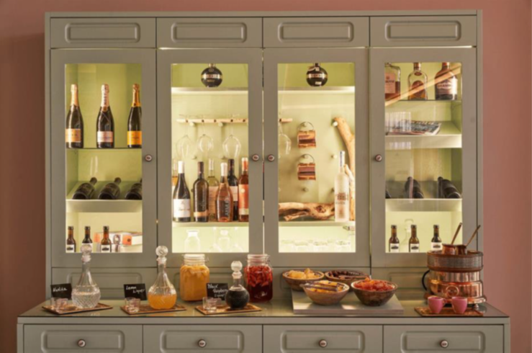
ENVIRONMENTAL& SOCIAL ISSUES
10

Slide 11
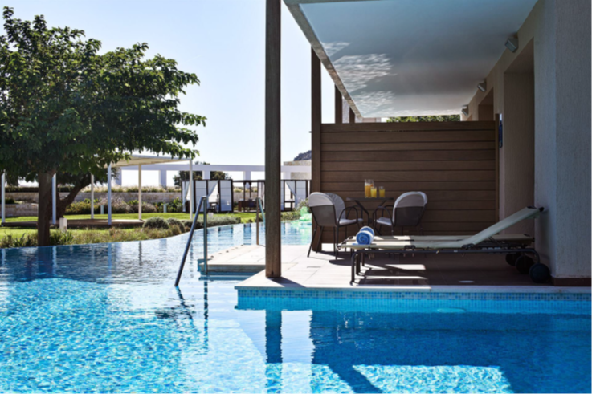
WATER
Water is sourced from the Local Municipality
All laws are being adhered to
In the hotel we use the water properly, by implementing water saving practices while ensuring the satisfaction as well as the safety & health of our guests.
11

Slide 12
WATER SAVING MEASURES
Drip irrigation is used throughout hotel gardens.
Planted local plants that are less water demanding.
Information to our guests in TV channel rooms and info kiosk on water saving measures.
At least 90% of our staff is trained for the reasonable use of water during their daily duties.
Installed flow restrictors on taps in most guest rooms.
Staff is encouraged to report leakages from taps, pipes etc. and maintenance is rectifying immediately such cases.
WATER SAVING MEASURES
Daily maintenance checks in order to repair faults and leaks as soon as they occur.
All guest rooms are also provided with towel card which informs and encourages our clients to use their towel more than once.
12

Slide 13
ACTIONS TAKEN FOR ENSURING HIGH WATER QUALITY:
An extensive program of the microbiological and chemical pool water analysis is carried out on a monthly basis.
pH and other parameters are checked daily in all swimming pools and are regulated by the automatic dosing system.
Microbiological analysis of potable water is performed monthly.
Legionella analysis is done before the opening of the hotel and various hotel spots are checked.
ACTIONS TAKEN FOR ENSURING THE SEA WATER QUALITY:
The beach in front of the hotel is a public beach and belongs to to Rhodes municipality. However, our hotel staff performs monthly beach cleans as a commitment to our community.
IRRIGATION:
The gardens are irrigated with irrigation water from the local municipality provided.
13
WATER QUALITY

Slide 14
WATER ASSESSMENT
14

Slide 15
WATER CONSUMPTION
KPI: 500 lit/pppd
2021 | 2022 | 2023
1235.3 | 510.4 | 506
2024
390.16
IMPORTANT NOTES:
Water consumption calculation for 2021is calculated with pandemics measures in place and reduced occupancy, thus the increased water consumption is justifiable.
A slight deviation of 2022 target is due to leakages in two pools which were fixed during the winter season.
Water consumption calculation for 2023 is until the end of August and the deviation is due to a broken water pipe which has already been fixed.
Water consumption calculation for 2024 is calculated until August, with measures in place and forecasted bed nights, it is expected to meet the target of 500 lit PPPD until the end of the year.
15

Slide 16
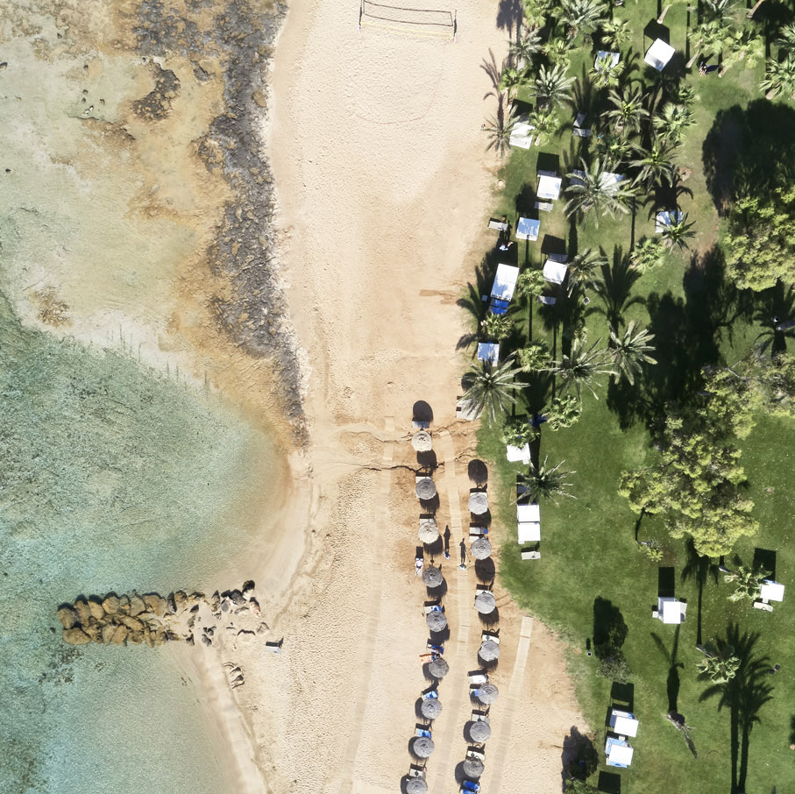
1
1
2
2
ENERGY SOURCES
ELECTRICITY
Electricity is monitored daily by the maintenance department in order to ensure the sensible daily consumption.
Electricity is obtained from ELPEDISON
Electricity is used primarily for A/C, refrigerators, pumps, lights and other equipment.
DIESEL
Diesel is used only for the generator, which is used only as a standby in emergency situations.
Diesel is obtained from Silk Oil .
16

Slide 17

ENERGY & CO2 EMISSIONS REDUCTION
LED installed in most rooms and hotel public areas.
Fluorescent LED Lamps installed in all back of house areas .
Automated systems have been installed in 100% of guest rooms to ensure the switching off of air conditioning and heating while the room is unoccupied.
All new equipment is purchased according to our environmental policy where energy efficiency is taken into consideration.
Information to our guests in TV channel rooms and info kiosk on energy saving measures.
Use of natural light for the lighting of the lobby and breakfast restaurant if possible.
C
2
The primary sources of CO2 emissions are from the electricity, fulel, diesel, LPG and natural gas consumption.
The reduction of Co2 emissions approach at At Atlantica Aegean Hotel.
We use club cars with rechargeable batteries for guest transportation.
Solar thermal panels are installed to reduce heating gas consumption.
A photovoltaic park is being installed during 2023-2024 to reduce energy consumption.
Hotel buildings are insulated to minimize heat loss.
Carbon dioxide (CO2) emissions are calculated monthly using the ESG platform.

Slide 18
ENERGY ASSESSMENT
18

Slide 19
ELELCTRICITY CONSUMPTION-YOY COMPARISON
KPI:22 kWh/pppd
2021 | 2022 | 2023
43.4 | 21.1 | 20.9
2024
22.56
*IMPORTANT NOTE:
Electricity consumption calculation for 2021 is calculated with pandemics measures in place and reduced occupancy, thus the increased water consumption is justifiable
Electricity consumption calculation for 2022 is until the end of August.
Electricity consumption calculation for 2023 is until the end of August.
Electricity consumption calculation for 2024 is until the end of August.
19

Slide 20
WASTE MANAGEMENT
(wastewater disposal)
The hotel is connected to the public sewage system.
The wastewater is randomly checked by the government authorities in order to be within the legal requirements for BOD , COD and other measurements.
Procedures are put in place to keep the BOD, COD and microbiological parameters of the wastewater within the legal requirements limits
Collection of old cooking oil and disposal through the approved supplier who uses it for biodiesel production.
Vinegar is used rather than chemicals for cutlery polishing.
20

Slide 21
WASTE REDUCTION & RECYCLING
Paper Reduction
Recycling
Alternatives SUPs
Suppliers
Reduction and reuse of paper consumption in the offices.
One sided printed paper is used as scrap paper and Furthermore recycled.
E-mail is used extensively for messaging.
Other non-domestic waste is separated for recycling which is:
PLASTIC
PMD
PAPER
BATTERIES
BULBS
WEEE
The Hotel provides large recycling bins, color-coded and placed them each department for waste separation and recycling.
One use plastic cups are replaced by re-usable polycarbonate glasses.
Plastic straws are replaced by paper straws.
Plastic bags and plastic cutleries/plates are replaced by paper bags and cutleries/plates.
Sugar, salt & pepper in the main restaurant during breakfast is served in re-suable glass container; individual packaging is eliminated.
We use refillable bath amenities instead of one use plastic.
Water coolants have been installed around the Hotel areas in order to eliminate plastic bottles.
We encourage suppliers to reduce packaging (fruit, vegs etc.)-purchasing departments checks the packaging upon evaluation of suppliers.
Buy products with recyclable packaging .
Buy in bulk (chemicals, oil, water, spices, sugar, flour, salt, beer, feta cheese, olives, vinegar, sauces, etc.).
21

Slide 22
SOLID WASTE PRODUCTION-YOY COMPARISON
KPI: 2kg/pppd
2021 | 2022 | 2023
1.30 | 1.07 | 1.96
2024
2.04
*IMPORTANT NOTE:
Waste production calculation for 2024 is until the end of August.
22

Slide 23
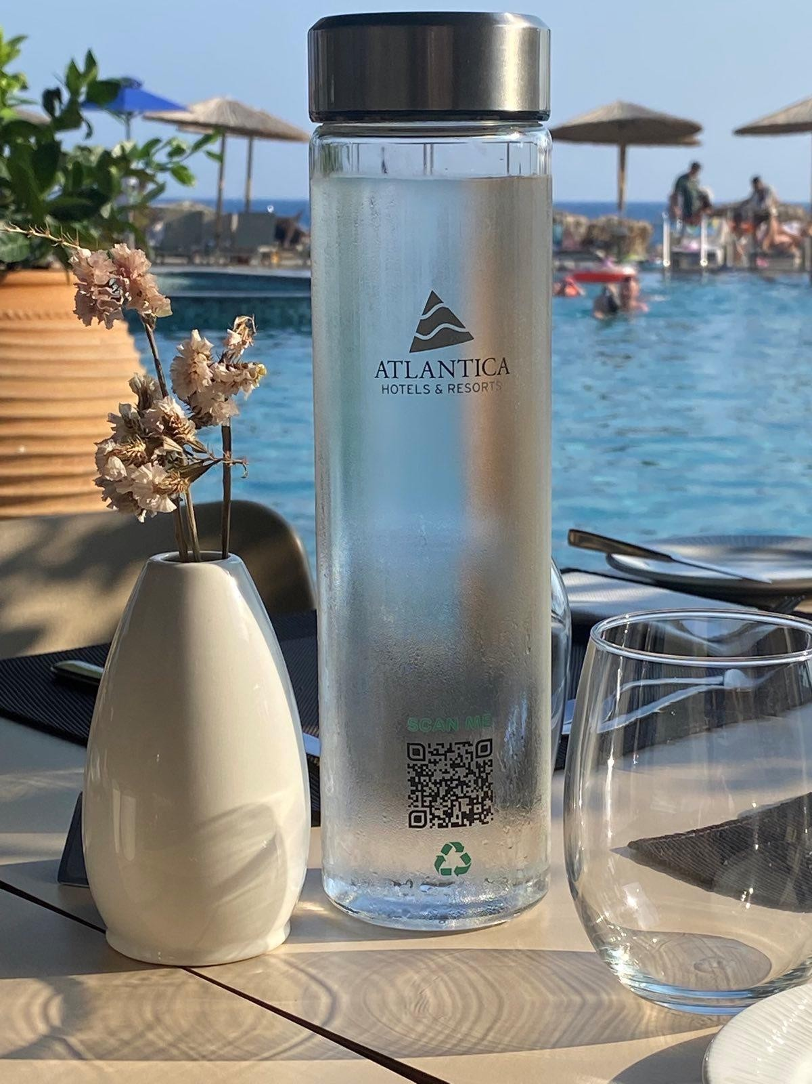
SUSTAINABILITY IMPROVEMENTS
CO2 emissions
Ιnstallation of a Photovoltaic park on the roof of the hotel with the aim of producing clean energy and reducing our energy footprint. 42pcs PV panels were installed
Electricity Consumption
Photovoltaics with a total generated power of 22kW were installed
2 new additional pumps for water heating were installed
Diesel
Ιs used only for the generator, which is used only as a standby in emergency situations
23

Slide 24
SUSTAINABILITY IMPROVEMENTS
Regarding Water Consumption
Replacement of broken sports pool overflow pipes
Replacement of broken center pool overflow pipes
Food Waste
Staff training for rational solid waste management and proper sorting of recyclable waste
We have replaced plastic bottles in all departments by installing water coolers, thus helping to minimize the use of plastic and improve our environmental performance
24

Slide 25
Internal and External communication
We are well aware that strong internal communication strategy will keep everyone on the same page and set the precedence of a collaborative environment. This builds team unity and makes employees and guests feel valued.
Internal Communication Leads to a Better Work Environment, therefore we are using below means of internal communication to improve our operations as well as reduce environmental and social impacts by choosing not to print or travel and we instead:
We encourage all management team members to communicate via e-mail
We send internal memos via e-mail
We use PDA for customer’s orders instead of captain orders blocks
Fact: We have at least 1500 orders daily which are no longer double recorded
We use departmental electronic stock request system
Fact: Each departmental stock order is at least 5 pages
We have a full electronic and remote access to the company processes and procedures
We use power point presentations for trainings
We use electronic records for staff trainings
We do REMOTE TEAMS meetings
25

Slide 26
Stakeholders
Stakeholders
Customers
Suppliers/ Subcontractors
Insurance company
Laboratories
Certification bodies
Society
Government
Employees
Management
Stakeholders are defined as individuals or groups whose interests are or may be affected by our activities, paying particular attention to the interested parties located in the areas where the respective hotel operates. A key element is the constant communication with the interested parties, while the communication channels between them and the company are analysed below.

Slide 27



Stakeholder needs, expectations and communication, including compliance requirements
Stakeholders | Needs & Expectations | Compliance requirements | Communication channels | Language
Customers | High quality services, according to the contract Consistency Confidence Compliance with legal requirements, regarding compensation | Monitoring of evaluations Strategic partnerships with the UK. Staff competence & internal procedures. Internal inspections according to GL-GE-P-005. | Corporate website Announcements Annual Report on Sustainable Development Guest Relations Communication with relevant departments Customer Questionnaires/ Evaluation Events Emails Atlantica application | Greek/ English/ German
Suppliers/ Subcontractors | Good cooperation with suppliers Clarity in requirements Combination of consistency, quality & price | Purchases in accordance with procedure AS-PU-P-010. Evaluation of suppliers according to GL-GE-P-120 procedure. | Meetings Evaluation Emails Annual Report & Sustainable Development Report | Greek/ English
Insurance company | Follow-up of requirements and proposals of insurance companies & brokers to improve policies and reduce major risks | Signing of liability & property insurances annually. Holding meetings every year before signing the above. | Send files Emails Meetings Teleconferences | Greek/ English
27

Slide 28



Stakeholder needs, expectations and communication, including compliance requirements
Stakeholders | Needs & Expectations | Compliance requirements | Communication channels | Language
Laboratories | Perform analyses and measurements using accredited methods | Annual cooperation agreement with the Chemicothechniki laboratory. Monthly Sampling Schedule. Equipment calibration by the Globetech company in March and June. Noise measurements by Globetech. | Emails Meetings Annual Report & Sustainable Development Report Chemicotechniki platform/ results uploading | Greek/ English
Certification bodies | Compliance with the requirements of ISO standards Annual certification/surveillance inspections | IMS review & revision. Internal & external inspection program. Carrying out certifications. | Send files Emails Meetings/ Inspections Annual Report & Sustainable Development Report | Greek/ English
Society/ Community | Encourage the volunteering for actions related to the place or society Supporting the society where the hotels operate | The hotel carried out several actions this year as well. Also, some were planned for the next period of time. They are presented in detail in the file GL-EN-F-040-ESG Programme. | Annual Report & Sustainable Development Report Events Sustainability actions | Greek/ English
28

Slide 29



Stakeholder needs, expectations and communication, including compliance requirements
Stakeholders | Needs & Expectations | Compliance requirements | Communication channels | Language
Government | Issuance of all permits as defined in the relevant legal requirements Review of legal requirements | The hotel has all the necessary permits, which are kept on file. An annual review of statutory requirements is carried out in file GL-GE-F-011. | Submission of data in the context of participating in programs Letters Emails Annual Reports Press Releases/Announcements | Greek
Employees | Management leadership (strategy, decisions) Good collaboration within the organization Knowledge for correct execution of tasks Staff development program | Quality & HR policies are followed. Targets have been set (GL-GE-F-160) and are being monitored. Define & achieve annual training program (GL-GE-D-130/v12) Appraisal & promotion potential. Nomination of student/employee of the month with monetary reward. | Communication of group policies Open daily communication with Management and HODs Meetings between HOD’s and employees Events Trainings Staff Handbook Emails | Greek/ English
Management | Achieving business results Fulfilling the commitment to the customer Good relationship with customers | Measurement of results & their evaluation Awards Staff training (SOPs) Certifications | Annual general meeting Corporate website Meetings Teleconferences | Greek/ English
29

Slide 30
Stakeholders
Communication per thematic section | Stakeholders | Communication Channels | Language
Communication of policies and crisis management policies. |  | Atlantica website Email | Greek/ English
Training on health and safety, quality assurance and crisis management policies. |  | Live/Online trainings | Greek/ English
Accessibility information. |  | Atlantica website Sustainability Report | Greek/ English
Public sustainability document. |  | Atlantica website | Greek/ English
Seeking feedback. |  | Email Meetings Audits Implementation of ISO standards | Greek/ English
Inviting community feedback. |  | Email Meetings and contacts with municipality | Greek
Respecting local indigenous peoples. | Ν/Α | Ν/Α | Ν/Α
Employment terms and conditions. |  | Interviews Contracts | Greek/ English
How staff can raise concerns and make complaints. |  | Trainings Employees handbook Discrimination, Violence & Harassment at work policy | Greek/ English
Disciplinary procedure. |  | Employees handbook | Greek/ English

Slide 31
Stakeholders Communication- per thematic section
Communication per thematic section | Stakeholders | Communication Channels | Language
Communication of policies and crisis management policies. |  | Atlantica website Email | Greek/ English
Training on health and safety, quality assurance and crisis management policies. |  | Live/Online trainings | Greek/ English
Accessibility information. |  | Atlantica website Sustainability Report | Greek/ English
Public sustainability document. |  | Atlantica website | Greek/ English
Seeking feedback. |  | Email Meetings Audits Implementation of ISO standards | Greek/ English
Inviting community feedback. |  | Email Meetings and contacts with municipality | Greek
Respecting local indigenous peoples. | Ν/Α | Ν/Α | Ν/Α
Employment terms and conditions. |  | Interviews Contracts | Greek/ English
How staff can raise concerns and make complaints. |  | Trainings Employees handbook Discrimination, Violence & Harassment at work policy | Greek/ English
Disciplinary procedure. |  | Employees handbook | Greek/ English

Slide 32
Stakeholders Communication- per thematic section
Communication per thematic section | Stakeholders | Communication Channels | Language
Communication of policies and crisis management policies. |  | Atlantica website Email | Greek/ English
Training on health and safety, quality assurance and crisis management policies. |  | Live/Online trainings | Greek/ English
Accessibility information. |  | Atlantica website Sustainability Report | Greek/ English
Public sustainability document. |  | Atlantica website | Greek/ English
Seeking feedback. |  | Email Meetings Audits Implementation of ISO standards | Greek/ English
Inviting community feedback. |  | Email Meetings and contacts with municipality | Greek
Respecting local indigenous peoples. | Ν/Α | Ν/Α | Ν/Α
Employment terms and conditions. |  | Interviews Contracts | Greek/ English
How staff can raise concerns and make complaints. |  | Trainings Employees handbook Discrimination, Violence & Harassment at work policy | Greek/ English
Disciplinary procedure. |  | Employees handbook | Greek/ English

Slide 33
Communication with stakeholders, per thematic section
Communication per thematic section | Stakeholders | Communication Channels | Language
Reminders about using less energy. |  | Trainings Sustainability Policy Sustainability Report Atlantica website Info channel/guests rooms | Greek/ English
Reminders about using less water. |  | Trainings Sustainability Policy Sustainability Report Atlantica website Info channel/guests rooms | Greek/ English
Reminders about reducing waste. |  | Trainings Sustainability Policy Sustainability Report Atlantica website Info channel/guests rooms | Greek/ English
Customer information, suggestions, complaint registration. |  | Email Guest Relations | Greek/ English / German/ French/ Russian
How guests can report child exploitation and abuse. |  | Εκπαίδευση Policy | Greek/ English
Staff sustainability training. |  | Sustainability Report Training presentation | Greek/ English
Human rights statement for suppliers. |  | Sustainability Report Policies | Greek/ English
Linen and towel reuse policy. |  | Towel card/guests room | English
Information about how to separate waste. |  | Trainings Sustainability Policy Sustainability Report Atlantica website Info channel/guests rooms | Greek/ English

Slide 34
Guest Satisfaction Questionnaires
on the Hotel Environmental Performance
34

Slide 35
1
2
3
4
EMPLOYEES
ENGAGEMENT
PROCUREMENT
COMMUNITY ACTIVITIES
Hotel supports number of the local and international organisations such as:
Fire Brigade of Rhodes
'For nature Co.S.Ep’
Blood Donation department of Rhodes General Hospital
8 training per employee on an annual basis
45 % Of Local Employees
45 % of Female Vs Male
70% of part time staff Vs full time staff
40 % of Local Suppliers to the country
50% of local suppliers to the area of Hotel operation
50% of Suppliers with Quality & Environmental certifications (ISO 9001,ISO 14001,ISO 22000 etc.).
BEACH CLEAN – UP by the hotel staff
KID’S ENVIRONMENTAL ACTIVITIES (Sustainability Trail)
Provision of food for animals in shelters
Support and promotion of local suppliers

Slide 36
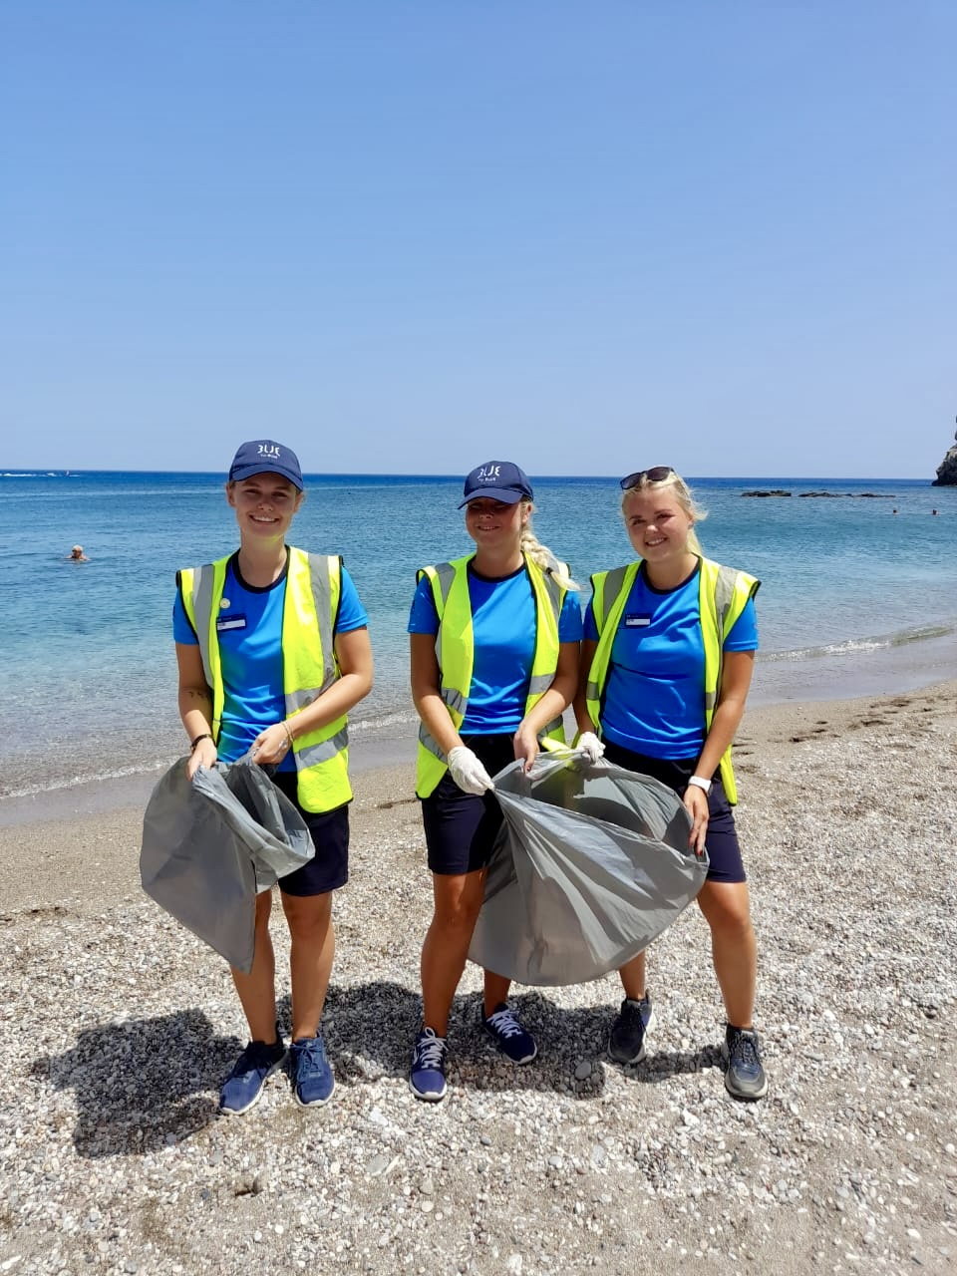
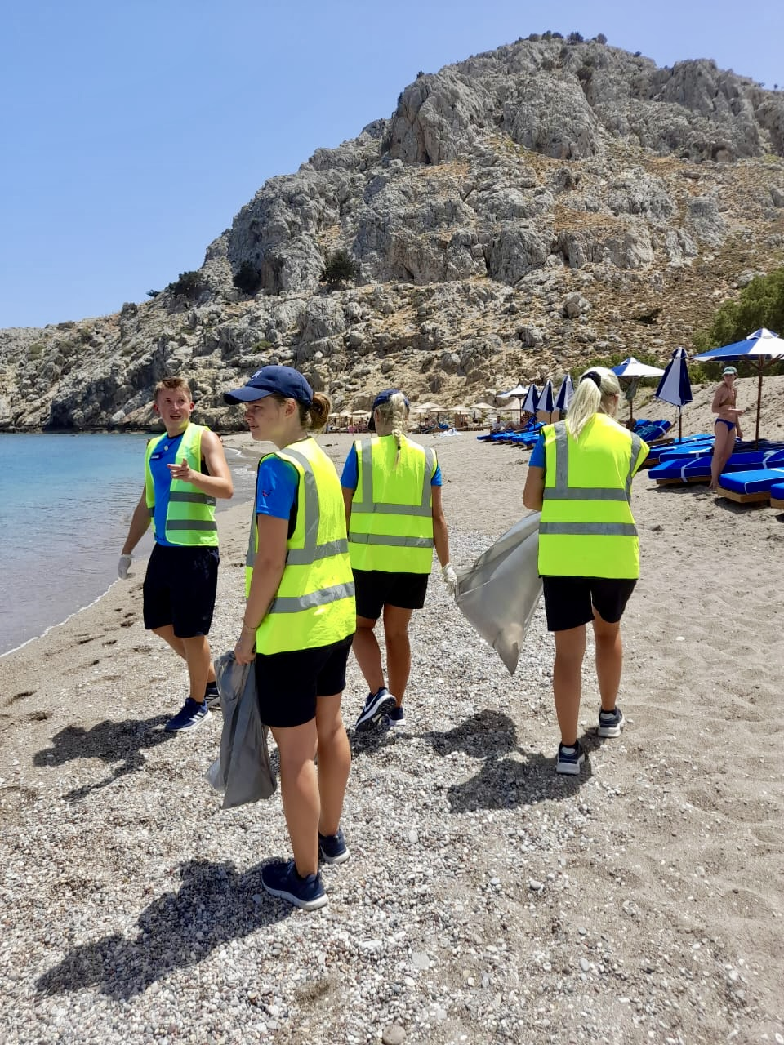
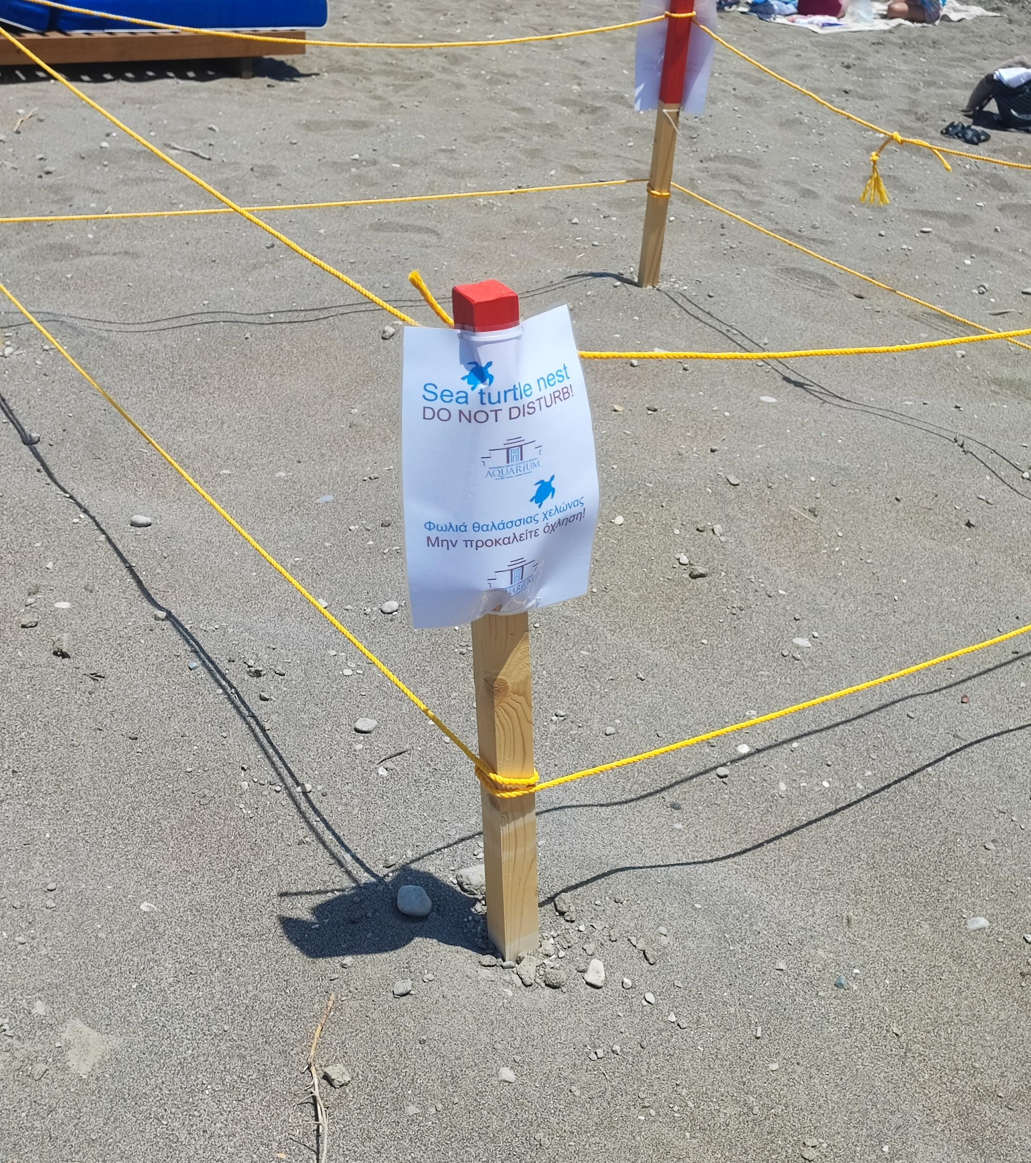
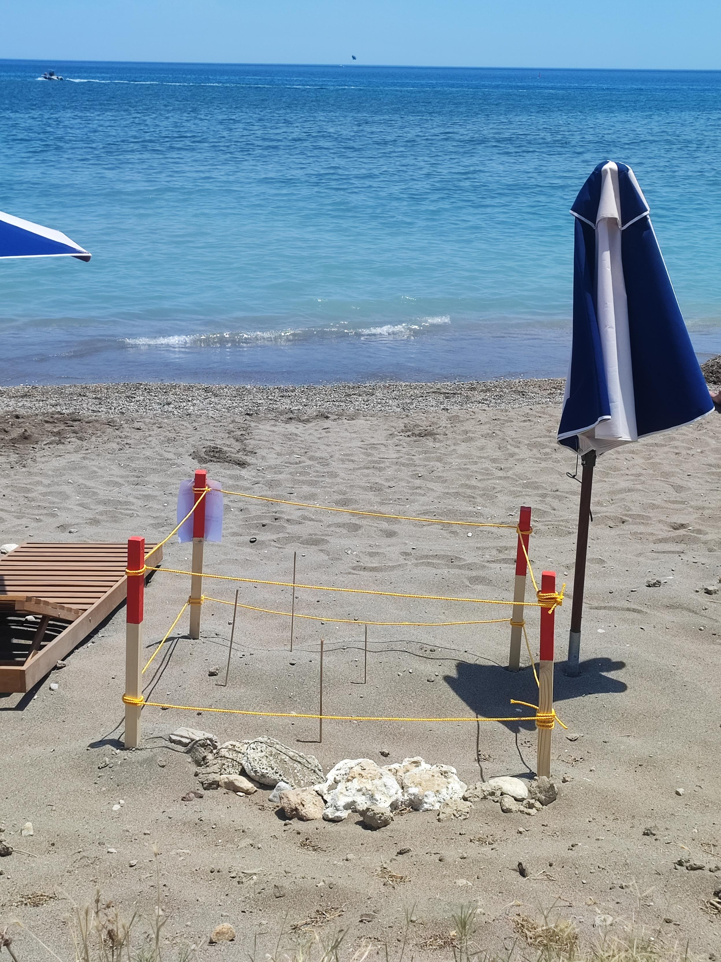
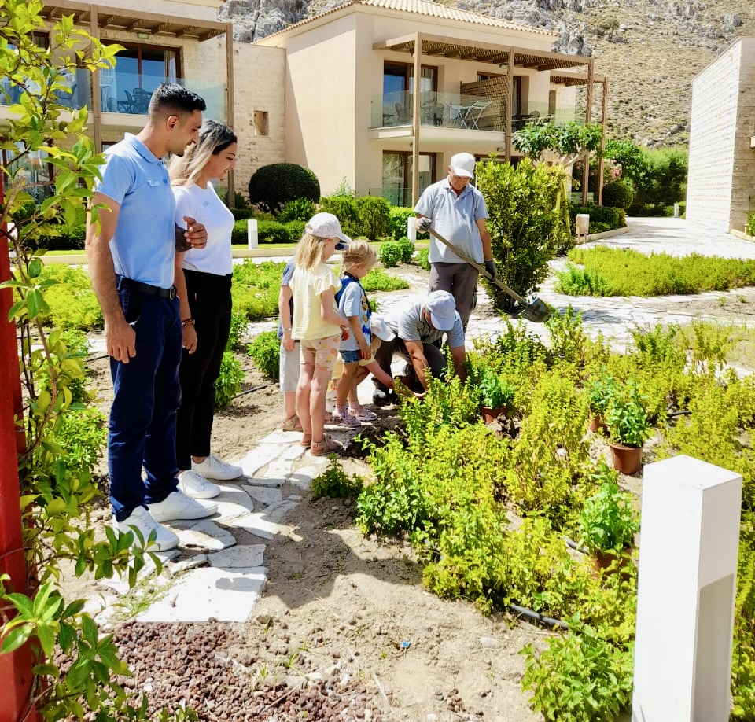
HOTEL ACTIONS & ACTIVITIES
Beach cleaning in front of the Hotel
World Environmental Day 2024
Protecting the turtle’s nests
Protecting the turtle’s nests from birds and people, and help them find their way into the sea
Olive oil trees painting
We painted the Hotel’s olive trees in order to protect them from pests.
36

Slide 37
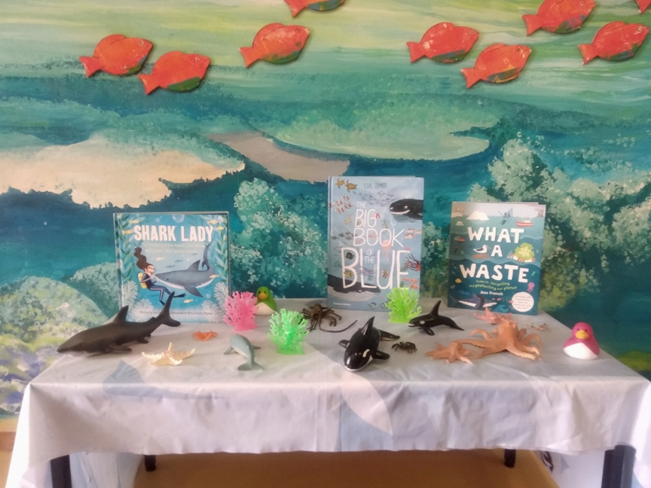
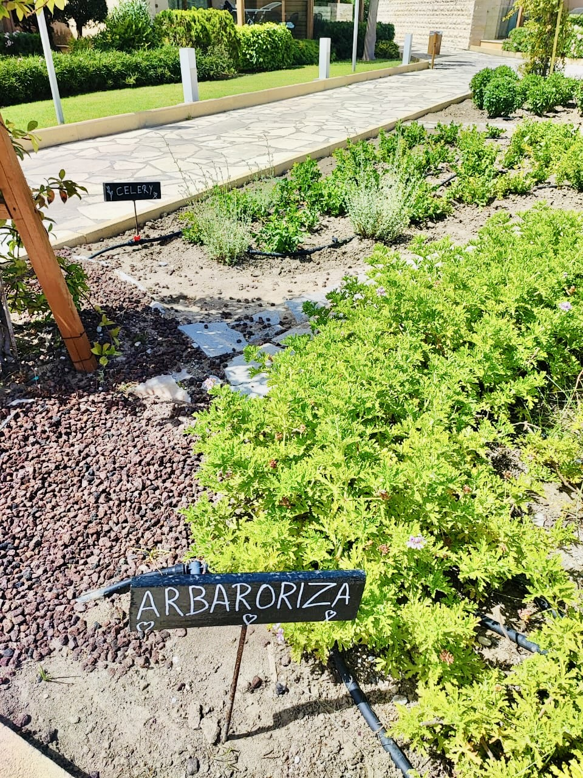
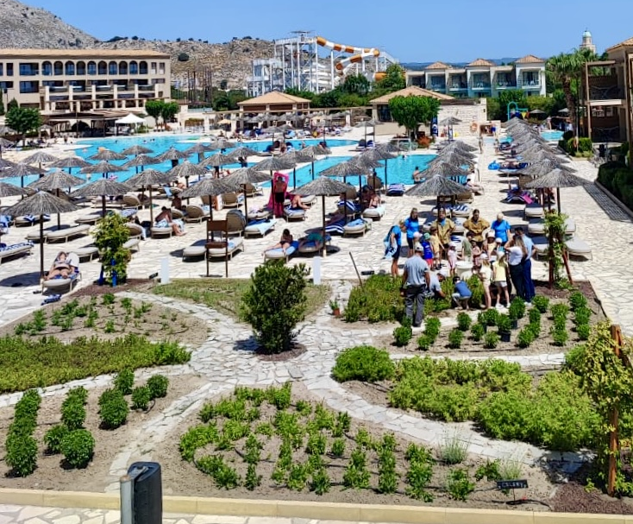
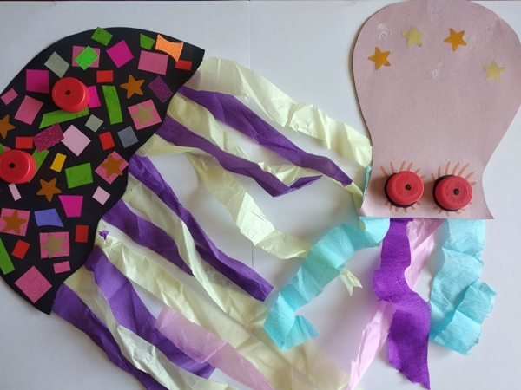
HOTEL ACTIONS & ACTIVITIES
Drawings by children with Ocean Life
World Ocean Day 2024
We used plastic lids for the drawings because it is important for the kids to learn that we should not throw plastics into the sea.
Our own garden!
Creation of small garden in the Hotel with organic vegetables and local herbs
37

Slide 38
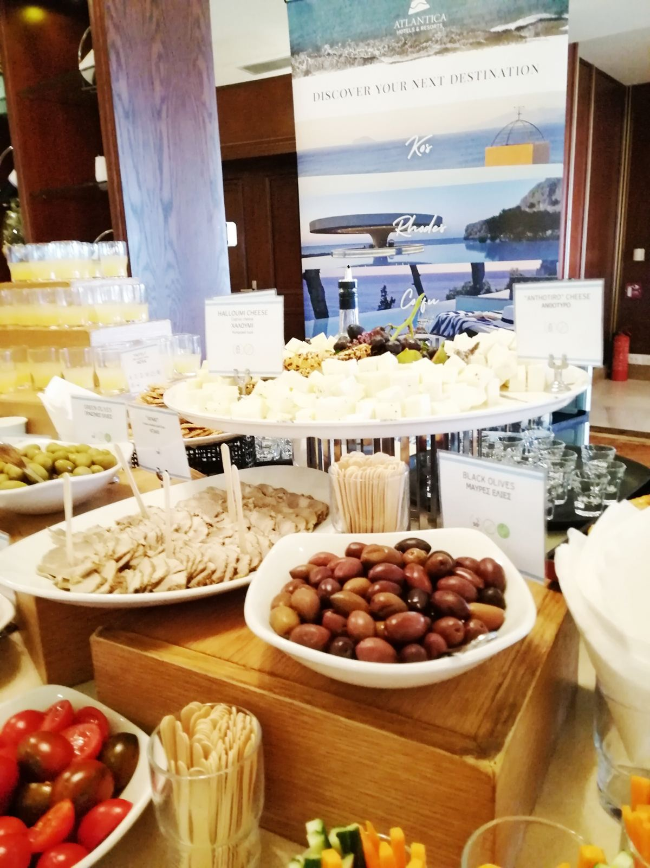
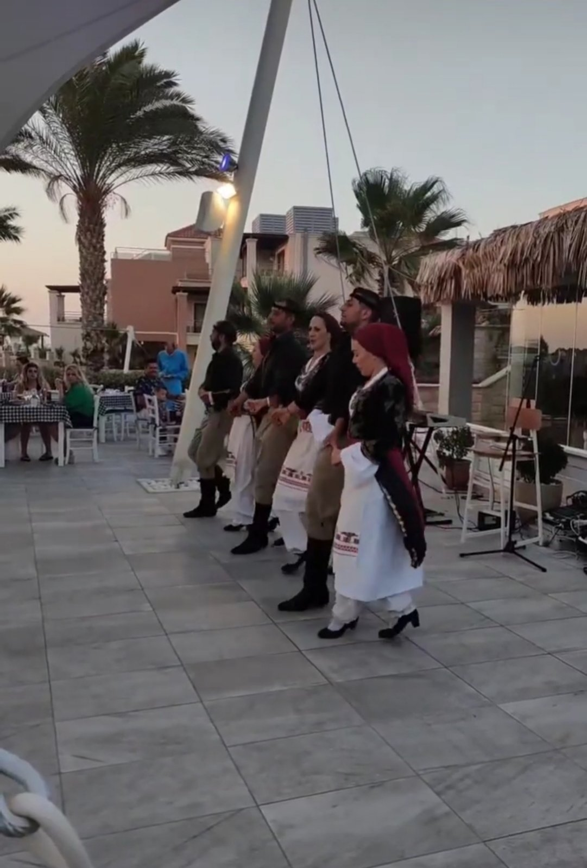
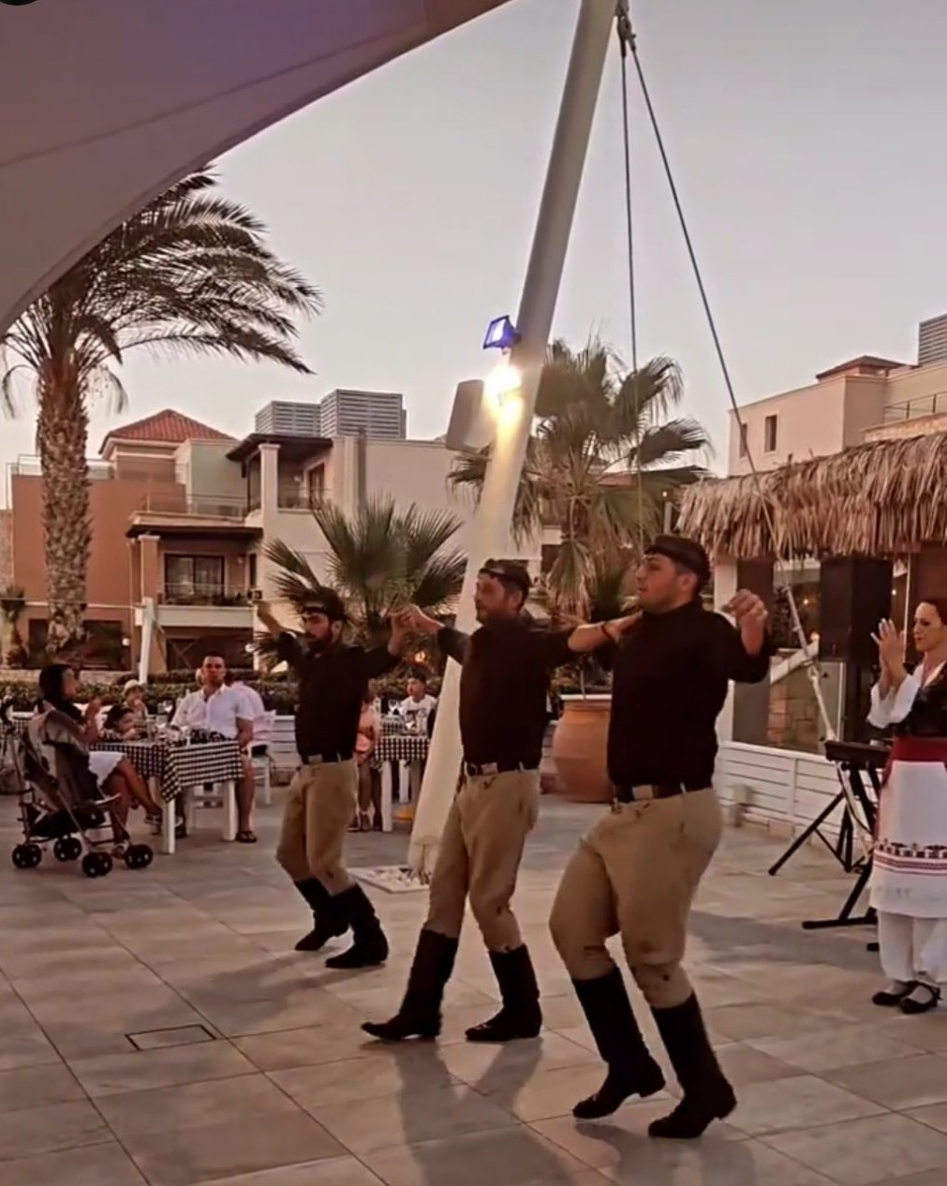
HOTEL ACTIONS & ACTIVITIES
Celebrate the World Tourism Day
We celebrated the World Tourism Day in cooperation with the Hotels of the area, by promoting the Greek Hospitality and our local products
Cretan Nights
By organizing the Cretan Nights, we promote the local customs and the local food. Also, a Cretan group of dancers presents traditional dances to our guests every Wednesday.
38

Slide 39
COMPANY POLICIES
.
https://www.atlanticahotels.com/information/sustainabilty
39

Slide 40
THANK YOU!
https://www.atlanticahotels.com/information/sustainabilty
40

